Slide 1

Building a regression ML model to determine key factors and bias in medical insurance charges.
Artificial Intelligence and Machine Learning – CMP5367
Birmingham City University
Written by:
Alex Rush 23140056
Zakaria Miah 23229944
Orlando Igwe 231169111
Mohammed Shams 24140905

Slide 2

Introduction (Alex)
This is a regression learning task (Supervised) and the aim is to predict the insurance charge (continuous value) based on a few variables.
Objectives/questions
What are the key factors that influence insurance charges?
Is the evidence of bias or disparity in insurance charges based on demographic features?
Can we train a ML model accurately to predict insurance charges on customer features?

Slide 3
Dataset Description (Alex)
The source of the data is from Kaggle, and it is originally a synthetic dataset from the ML Book (ML with R by Brett Lantz)
Key Variables
Age
Sex
BMI
Children
Smoker Y/N
Region
Charges

Slide 4
Data Preprocessing (Orlando)
Missing Data:
0 missing values were found the dataset.
Encoding:
Label Encoding was used for binary values (e.g. sex, smoker).
One-Hot Encoding was used for nominal values (e.g. region).
Outlier Treatment:
The IQR Method was used to identify extreme values.
Capping was chosen instead of deletion to retain 100% of the valuable data.
Standardization:
StandardScaler was used to ensure that the age and BMI features have a zero mean and unit variance.
Enhance the performance of machine learning models.

Slide 5

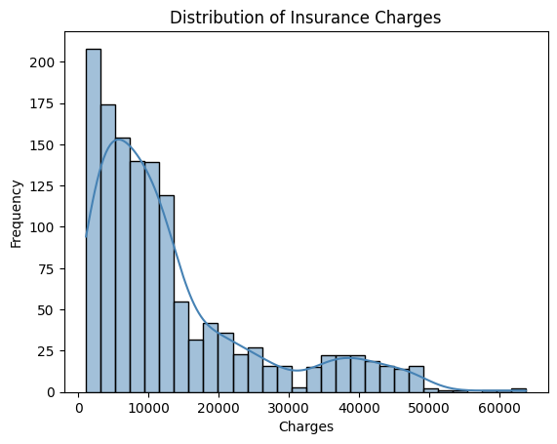
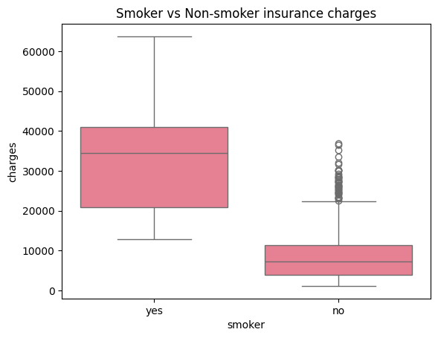
Exploratory Data Analysis (EDA) (Orlando)
Target Variable Distribution (Charges)
The distribution is highly positively right-skewed (non-normal)
Suggests the choice of non-linear models (Random Forest, Gradient Boosting).
Most Influential Predictor
The Smoker variable has significant factor, creating the largest mean difference.
Non-smokers rarely exceed high charge thresholds.

Slide 6

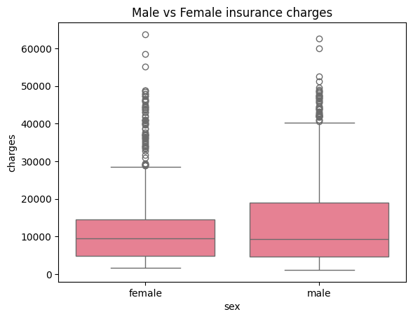
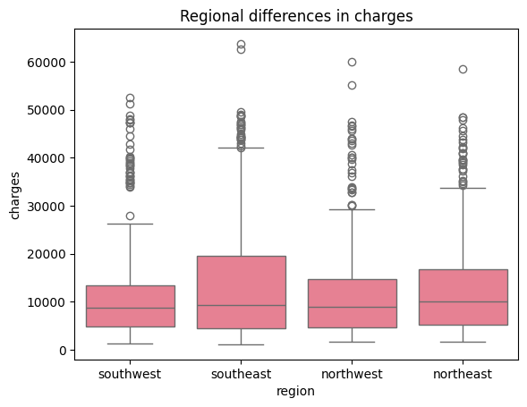
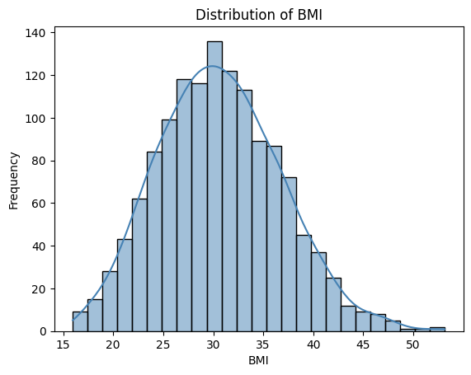
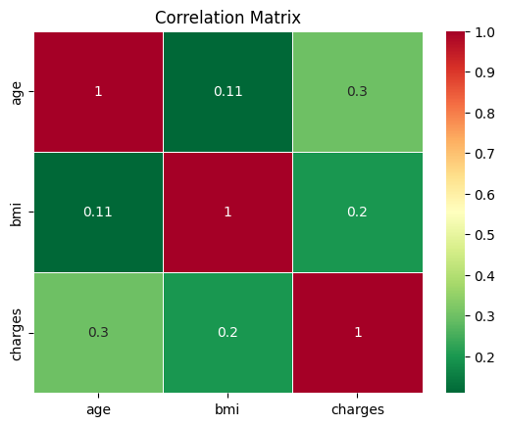
Exploratory Data Analysis (EDA) (Orlando)
Bias and Fairness Analysis
Analysis showed minimal variation in charges across different sex and region groups.
Bias is mostly linked to smoking, rather than the demographic groups.
BMI Contextual Fact
Average BMI in this dataset is 30.66, placing them in the Obese category
Feature Correlation
Correlation Heatmap confirmed high positive correlation between Smoker and Charges.
It also shows low multicollinearity between predictor variables.

Slide 7
Model Selection (Mohammed)
Linear Regression
Random Forest Regressor
Gradient Boosting Regressor
Support Vector Regressor
Ridge/Lasso Regression

Slide 8
Linear Regression
Chosen For:
-Good for basic relationships between features
-Highly interpretable results
-Good foundation for later model comparison

Slide 9
Random Forest
Chosen For
-Handles linear and non-linear very well
-Improved accuracy over other models
-Handles outliers well

Slide 10
Gradient Boosting
Chosen For:
-Building on small errors from previous models
-Captures feature interactions better
-Smoother and more precise predictions in comparison

Slide 11
Support Vector
Chosen For:
-Scaled input required
-Used normalisation applied in earlier models
-Captures smaller cost variations
-Scaling improves model sensitivity
-Better feature fairness

Slide 12
Ridge/Lasso Regressor
Chosen For:
-It's regularisation function to improve generalisation
-Adds a penalty to the loss function based on input coefficient
-Reduces data complexity
-Presents overfitting

Slide 13
Model Training & Evaluation (Zak/Alex)
20:80 Test-Training Split
Regular training and fitting of six models:
Linear Regression
Random Forest
Gradient Boosting
Scale Vector Regression
Ridge Regression
Lasso Regression

Slide 14
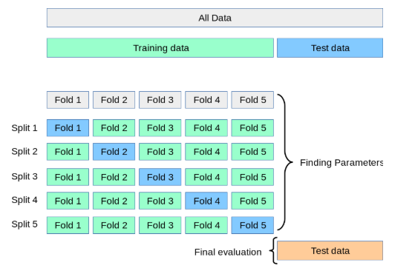
Model Training & Evaluation (Zak/Alex)
5-Fold Cross Validation on five models (excluding SVR) to:
Reduce Overfitting
Utilize the data more efficiently
Produce more reliable R² Scores

Slide 15
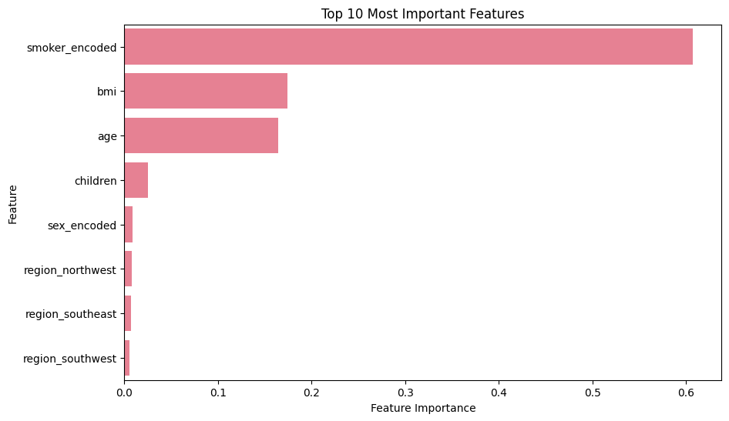
Model Training & Evaluation (Zak/Alex)
Analysing Feature Importance using the feature_importances_ method from the Random Forest class

Slide 16
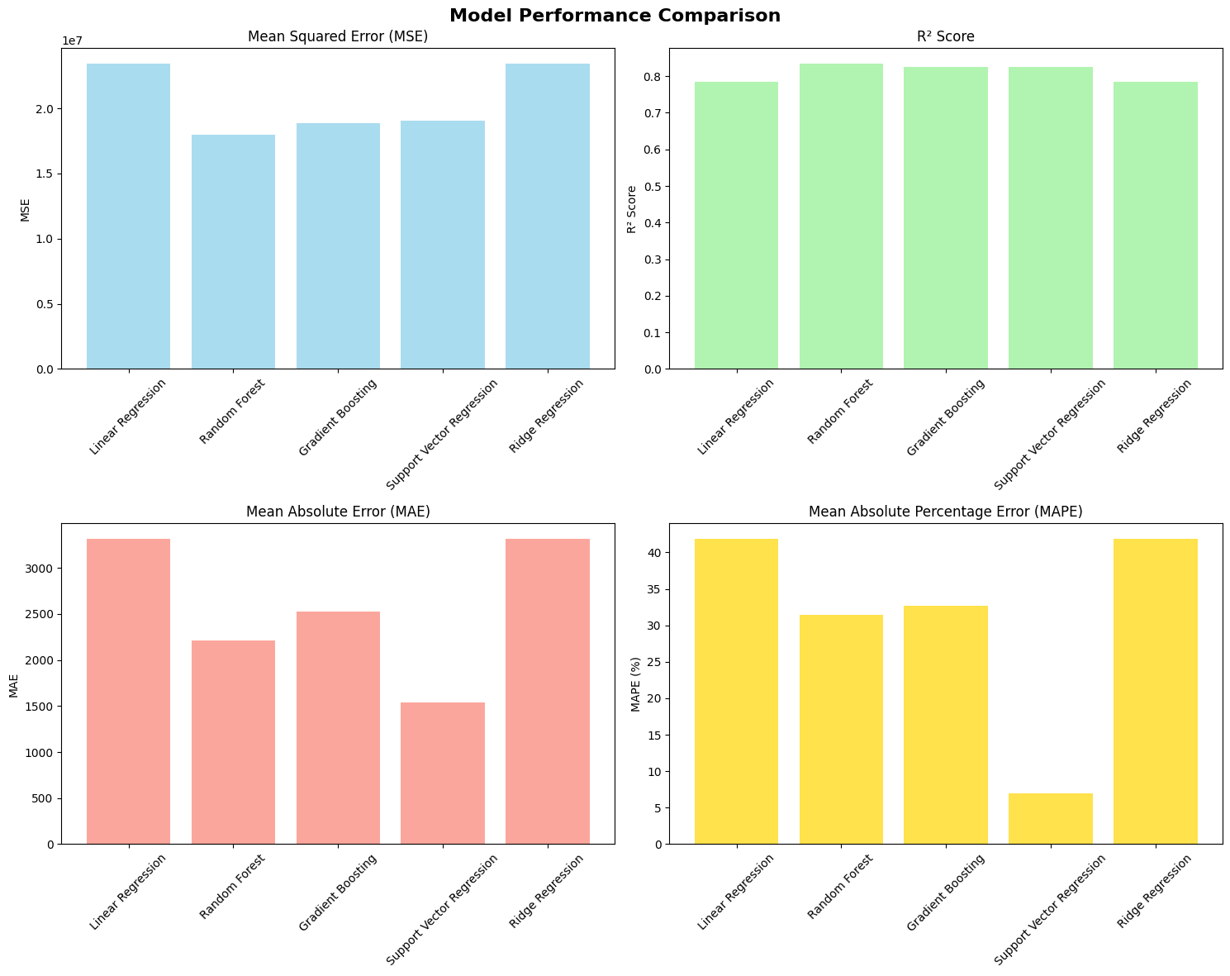
Model Training & Evaluation (Zak/Alex)
Similar results in accuracy metrics produced by Random Forest, Gradient Boosting and Scale Vector Regression
Negligible improvement from regularized models, e.g. Ridge and Lasso Regression
Indicate a bias towards non-linear feature(s), like the smoker class

Slide 17
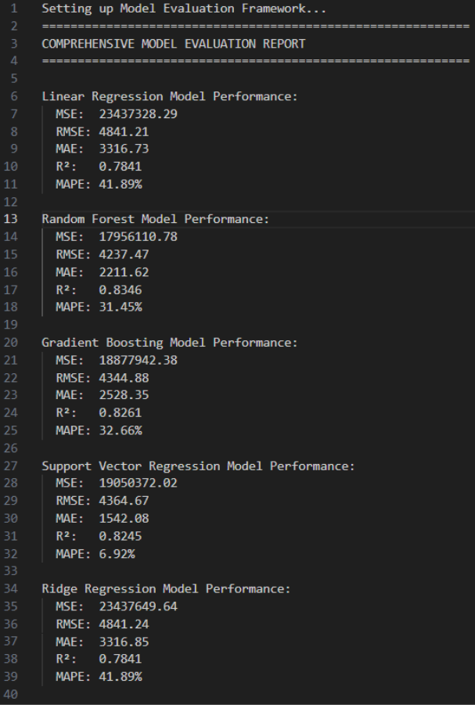
Results & Discussion (Alex)
The most accurate model was the Random Forest Model with gradient boosting coming 2nd.
Random Forest has the lowest MSE (17,956,110.78) and the second lowest MAE (2,211.62).
Making it the most accurate model

Slide 18
Challenges (Alex)
Computational Costs
Grid Search (Very resource intensive)
Overfitting Risks
Tuning can lead to overfitting if validation isn't good
Parameter Selection
Parameter selection required research into what was best
Interpretability
Some models (XGBoost) have a lot of hyperparameters making it hard to interpret

Slide 19
Lessons learned (Alex)
Data processing
Exploratory Data Analysis
Model Selection and Training
Evaluation Metrics
Feature Engineering
Interpretability
Practical Coding Skills
Critical Thinking

Slide 20
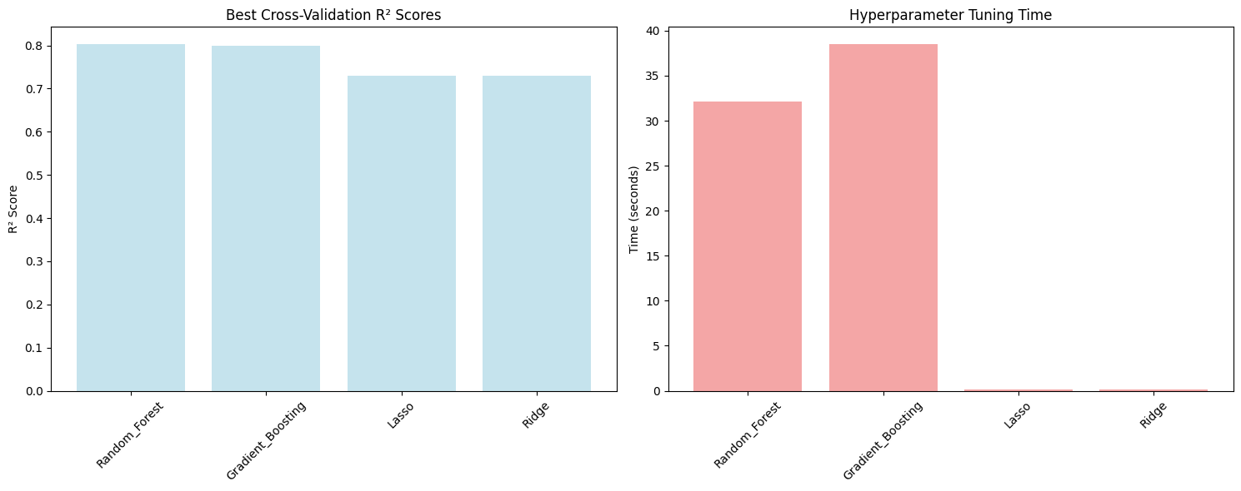

Slide 21
References
Sources, libraries, tools used

